Slide 1
Stacks
Chapter 7
Notes:
1

Slide 2
Chapter Contents
Introduction
Linear (Array) Stack Implementation
Linked Stack Implementation
Stack Implementation: Derived Class
Stack Applications

Slide 3
Objectives
Learn how to implement a stack as an array
Test the array implementation of stacks using the palindrome application

Slide 4
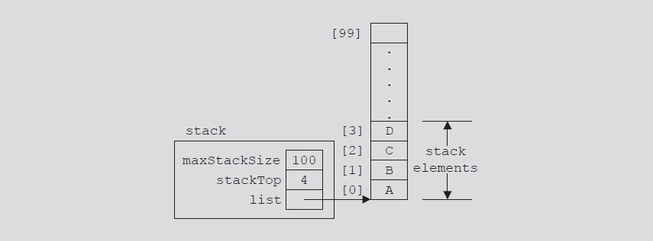
Implementation of Stacks as Arrays
Put first stack element in first array slot, second stack element in second array slot, and so on
Top of stack: index of last element added to stack

Slide 5
Implementation of Stacks as Arrays
Stack element accessed only through the top
Problem: array is a random access data structure
Solution: use another variable (stackTop)
Keeps track of the top position of the array

Slide 6
The StackType Class
StackType <Type>
*stack : Type
maxSatckSize : int
stackTop: int
StackType( int = 100 )
initializeStack( ) : void
isEmptyStack( ) : boolean
isFullStack( ) : boolean
push(Type ) : boolean
peek(Type ) : boolean
pop(Type ) : boolean
getStackSize( integer ) : void
getStackMaxSize( integer ) : void
printStack( ) : void
~StackType()

Slide 7
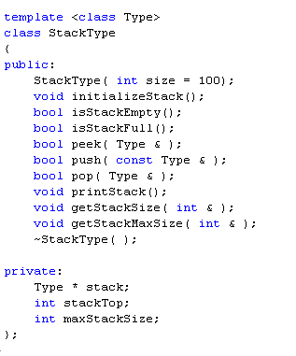
Implementing The StackType Class

Slide 8
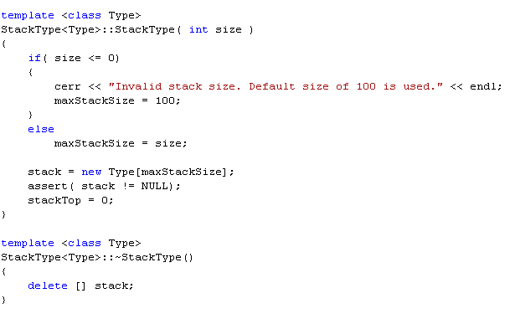
Implementing Constructor & Destructor

Slide 9
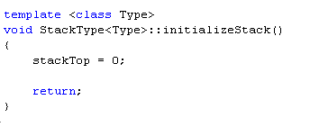
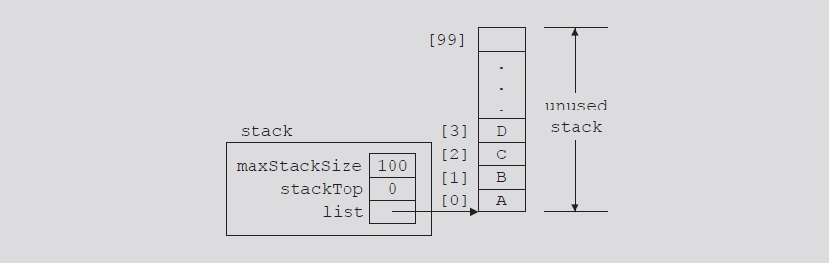
Initialize Stack
Reset stackTop to zero to initialize the stack

Slide 10
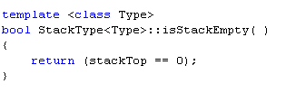
Empty Stack
Value of stackTop indicates if stack is empty
If stackTop is equal to zero: stack empty
Otherwise: stack not empty

Slide 11
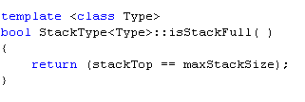
Full Stack
Value of stackTop indicates if stack is full
If stackTop is equal to maxStackSize: stack full
Otherwise: stack not full

Slide 12
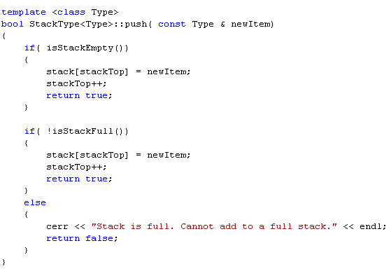
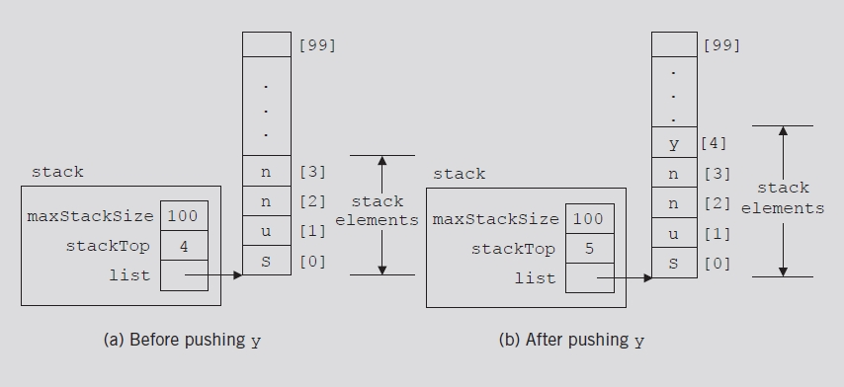
Push
Store newItem in array component indicated by stackTop
Increment stackTop

Slide 13
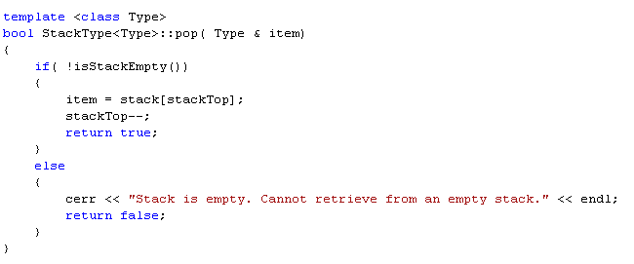
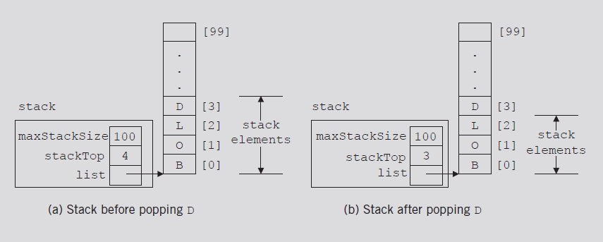
Pop
Store array component indicated by stackTop in item
Decrement stackTop

Slide 14
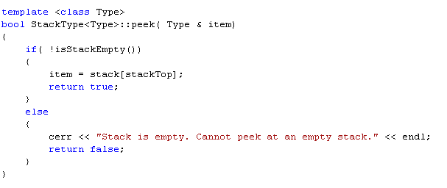
Peek
Similar to the pop operation but we do NOT decrement stackTop

Slide 15
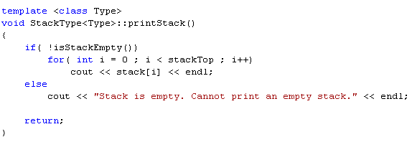
Print
Display contents of the stack

Slide 16
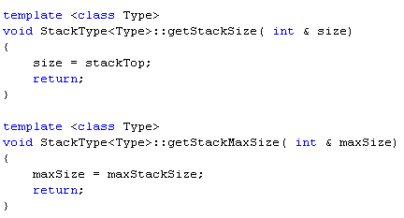
Utility Functions: Stack Sizes

Slide 17
Palindromes
A palindrome is a string that is spelled identically backward and forward
Examples:
RACE CAR
A TOYOTA

Slide 18
Testing the StackType Class
Write a program that uses a stack object to determine if a string is a palindrome.

Slide 19
Section 2 - End

